Slide 1

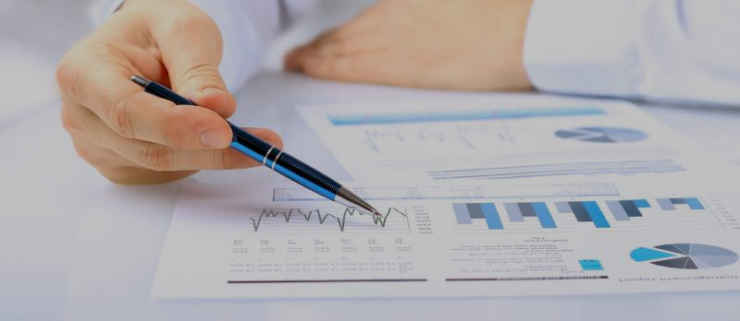
Software License Management
Project Proposal

Slide 2

Software as an Asset
Large organizations license and use several software for
development, administration and management
Office building, machinery, etc. are tangible assets
Most software is Sold as a Service (SaaS) nowadays
Software is an intangible asset
A piece of software can be a fixed asset for an organization

Slide 3
Software Licenses
Organizations buy licenses to use softwares from other organizations
C
Org 1
B
Org 2
A
Transaction
License agreements are transactional
Seller
G
Buyer
Organizations have buyer seller relationships
E
F
Relationships form a network of software licenses
D
Example of Network diagram

Slide 4



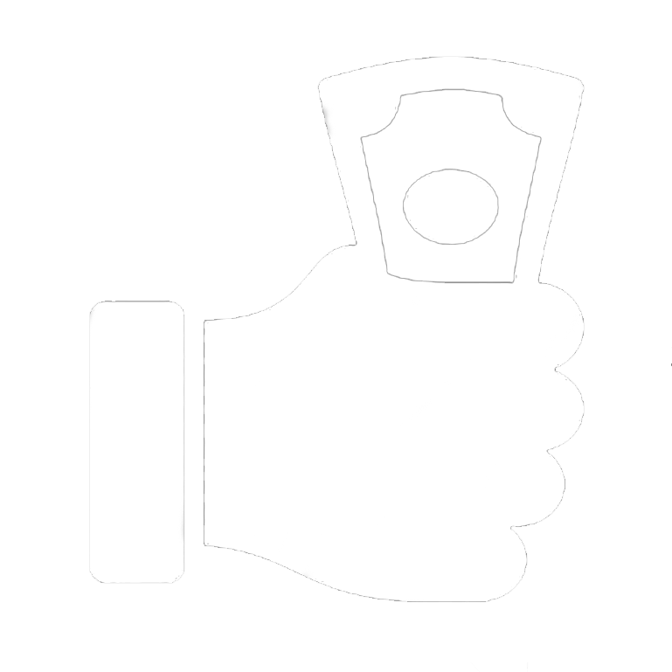

Business Problem
Hundreds of teams and projects in large organizations
Each team can autonomously license software i.e. decentralized
There is a high possibility of ::
Duplicate licenses
Unused licenses post project
completion/ team dissolved
Subscription fee for unused licenses
Thousands of unused licenses = millions of dollars

Slide 5

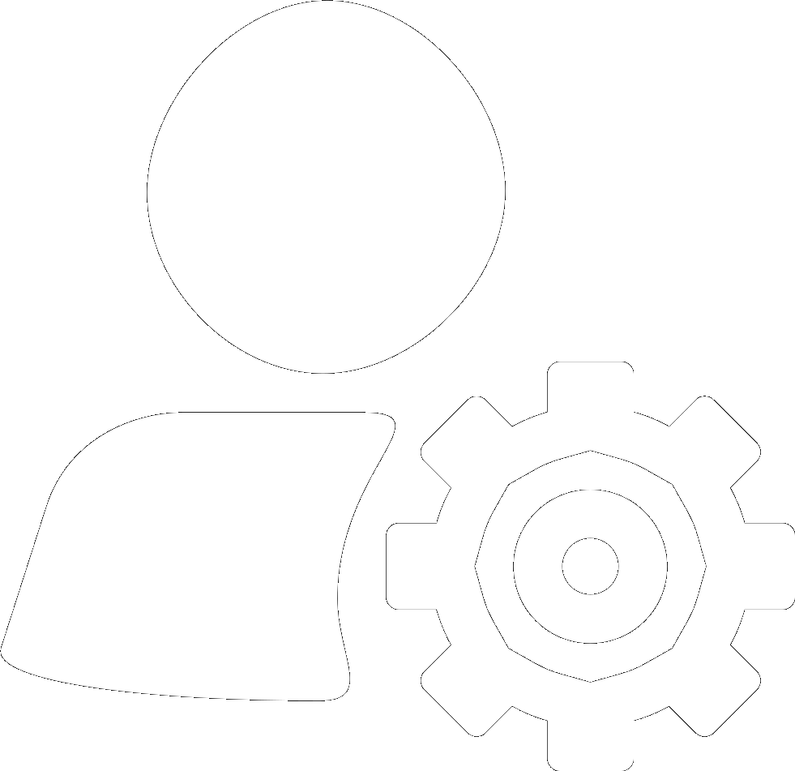
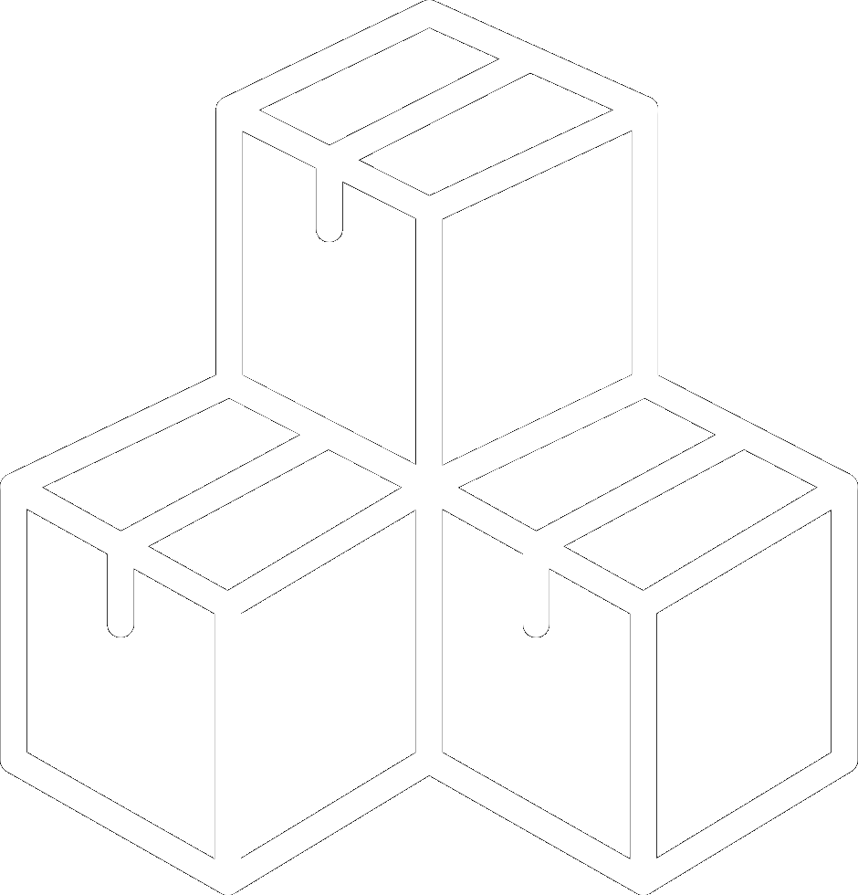

Management Challenges
License Issue
Licenses not managed by centralized team
Ownership Issue
Licenses data owned by software seller
Inventory Issue
No inventory of licenses
Data Issue
Creation of inventory of licenses is complex
Organizations should contact sellers to get data on licenses
Renewals and/expirations happen - data is dynamic

Slide 6
How do we solve this?

Slide 7
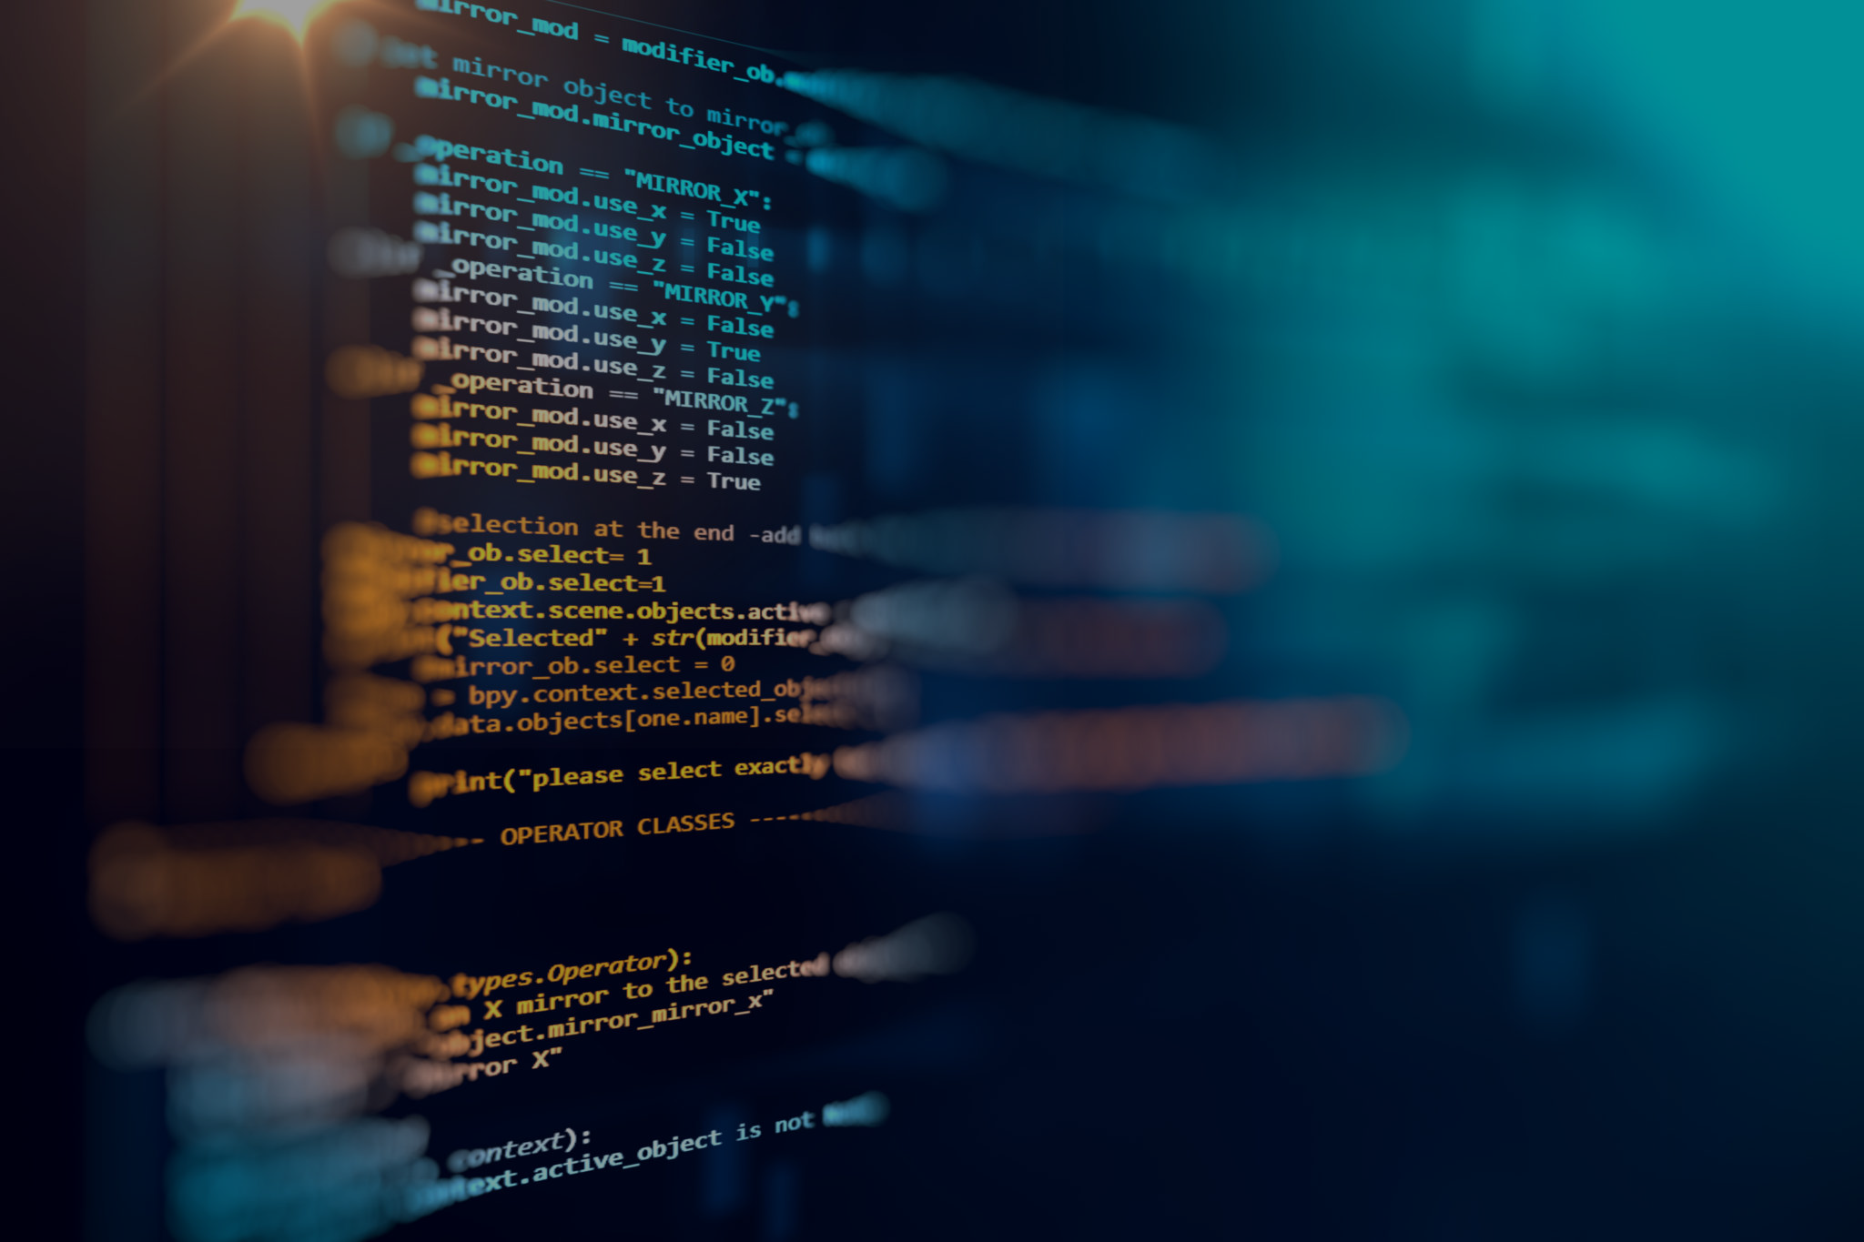
A New Approach
Reimagine buying of software asset (the licenses) as a transaction
Seller of software has data on these transactions
If sellers share this data, buyers can build a portfolio of assets
But, direct peer-to-peer sharing has many problems

Slide 8
Concerns to New Approach
Sellers must share their sales records with outside party
No defined standards – every seller independently must design software
Transactions should be delivered only to buyer, not any other party
Privacy and security when sharing
System design issues
Integrity, tamper-proof and validity of transactions
Extra work on writing data sharing programs

Slide 9
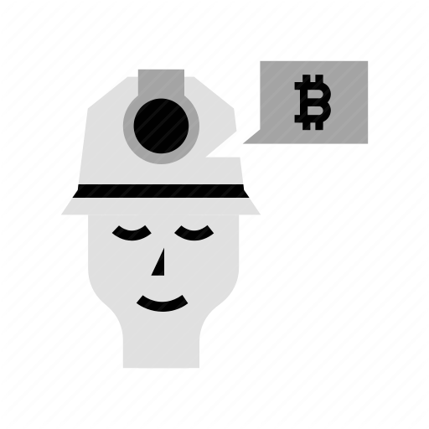




Blockchain to address the concerns
Blockchain is a technology to share transactions in a trusted, safe, secure and private way
A blockchain “miner” records transactions as a chain of events
Miner facilitates sharing of
transactions
Miner is a place for sharing license agreements between all peers
Each user maintains a ledger of their transactions
Events are verifiable and immutable in the blockchain
Buyers and sellers become peers or users
in a network

Slide 10
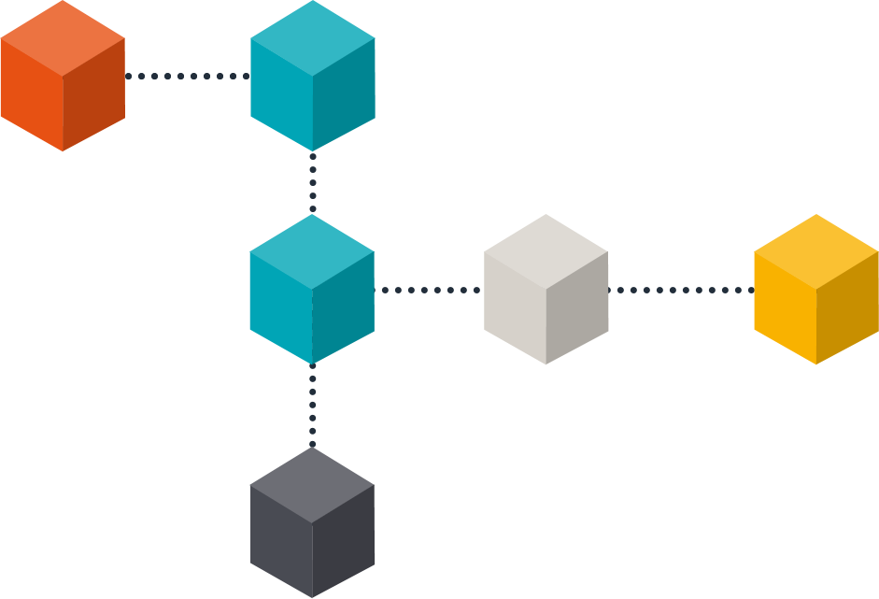
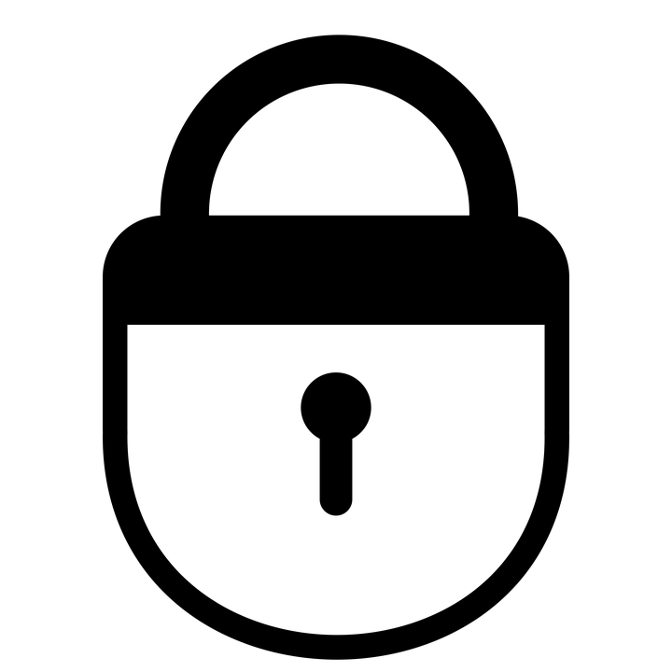
Visualising Blockchain
Blockchain, as name suggests is a chain of
blocks
Genesis block
#0
Hash: ad89dfk
Previous hash: 0
First block, called genesis block always
contains null
Each consecutive block contains a bunch of
transactions, a hash for the block and the
hash of its preceding hash
Hash: we56lop
Previous hash: adk89dfk
Transactions may be encrypted
Hash values enable integrity checks

Slide 11
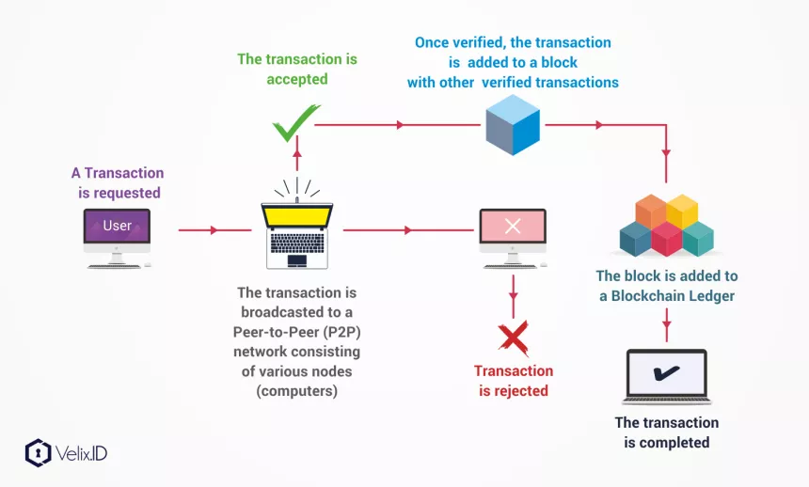
Visualising Blockchain

Slide 12
N - Tier Block
B
A
C
F
A
CM
C
G
D
G
D
B
C
E
A
D
D
A
C
F
B
E

Slide 13
What does Miner do?
Meditator
Verifier
Inventory Manager
Analytics
Facilitate transaction sharing
One-stop place for all licenses in network
Verify validity of every transaction
Ensure integrity of blockchain
Record all available licenses
Deliver license details to users
Dashboard for reporting
Consolidate license ownership
Show forecasts, suggestions, recommendations

Slide 14
Why Blockchain?
Ensure Safety
Ensure Trust
Ensure Privacy
Transactions encrypted and hashed
Transactions cannot be tampered
Sharing only between buyer and seller
Ensure Reliability
Scalable
Single-Solution
Miner verifies every shared transaction
Easily add/remove users in network
Any user sharing data has access to their licenses

Slide 15
Digging Deeper

Slide 16
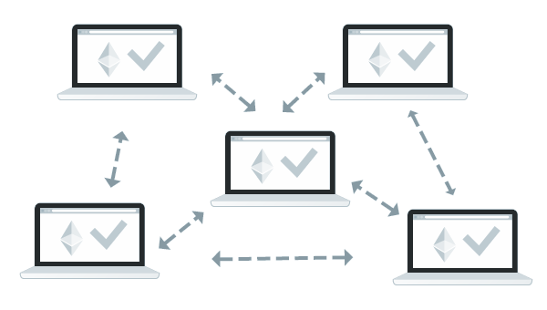




Introducing Ledgers
A ledger is a list of transactions – sale or purchase of software assets
Each user has their own ledger
Users can fill in sales – from active licenses in their software
Users do not have purchases – decentralized and not managed
Without purchases, ledgers are incomplete
Users interested in completing their ledgers
FAQ: Why should users have sales in their ledgers?

Slide 17
Ledgers: Initial Phase
B
G
B
E
Each organization fills in the ledger with their sales data
B
A
B
C
E
Purchase data missing – organizations interested in this
A
C
A
C
C
D
A
E
F
A
C
G
Goal is to complete the ledger with purchase data
A
F
C
B
CM
“-->” Indicates a sale transaction
C
G
D
E
D
F
G
D
D
B
C
D
G
“A --> B” shows that “A” sold some licenses of their software to “B”
G
D
E
A
In the initial phase, ledgers have only sale transactions
D
D
A
C
F
B
E
E
F

Slide 18
Completing the Ledger
Blockchain to share purchase transactions with buyers
Missing info in ledger filled from peers (other users) in network
1
2
3
4
A participating user adds their sales transactions to blockchain
Miner verifies transactions, ensuring integrity of blockchain
Miner delivers each transaction to respective buyer
Buyer adds received transactions to their ledger
This is why ledgers contain both sales and purchases

Slide 19
Completed Ledgers
B
G
B
E
B
A
Every company has added their purchase info to blockchain
B
C
B
A
B
C
E
Blockchain miner has delivered data to buyers
A
C
C
D
A
E
A
C
C
G
A
F
F
A
C
B
Buyers’ and sellers’ data are now in sync
A
F
C
A
CM
Each recorded sale “A --> B” of seller A has a copy “B <-- A”, received by buyer B
C
G
D
E
G
D
D
D
F
G
B
G
D
D
G
G
C
B
C
D
C
G
D
D
G
Each transaction is part of: seller’s ledger, blockchain and buyer’s ledger
E
A
D
D
A
C
E
F
“A --> B” - a record of sale from A to B
“B <-- A” - a record of purchase by B from A
F
B
E
E
A
F
A
E
B
F
D
E
C
F
E
E
D

Slide 20
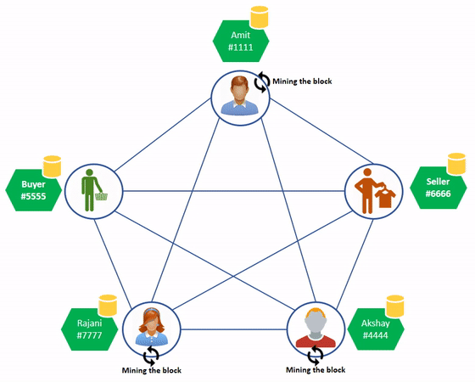
Who monitors the Miner?
Miner has access to all transactions in network and is responsible for ensuring integrity of blockchain
This leads to the question: who monitors the monitor?
Many miners!
Each miner independently maintains the blockchain
Verification works by taking majority vote among all miners’ responses

Slide 21

Notes
Miner stores all transactions that took place
Hashing and encryption enables peers to trust the miner
Ledger completion depends on participating organizations
If an organization owns licenses for a piece of software, but seller is not in network, ledger is not fully complete
Larger network = better ledgers

Slide 22

Conclusion
We solved the problem of software asset tracking and management
Single solution for all users, not just one organization
Blockchain technology is center piece

